Slide 1
Project report
Happy Greens. Mikhail Stukalo

Slide 2
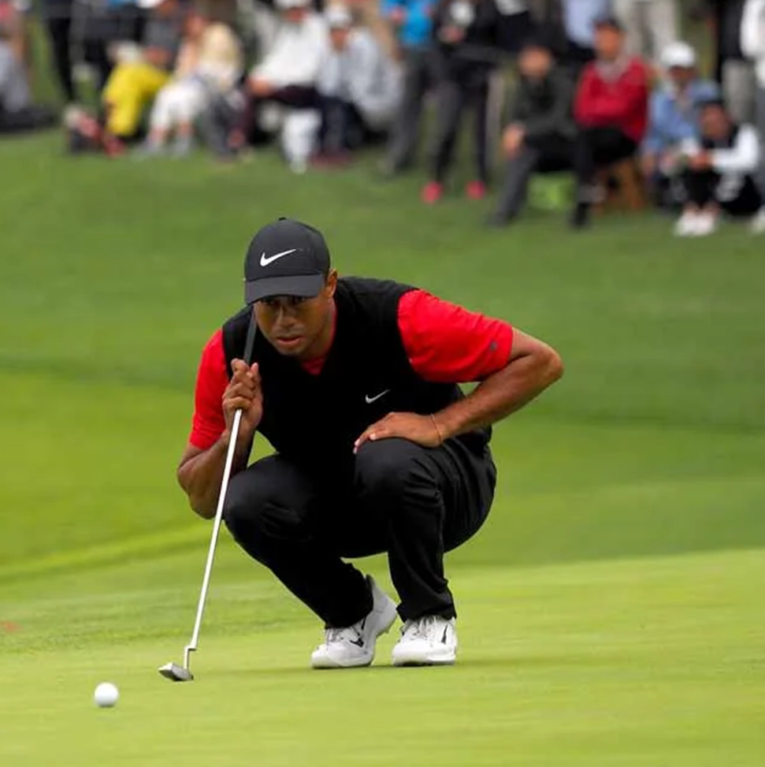
Project from Idea to Implementation
Build an ML algorithm that predicts hit or miss for golf putting
The algorithm can be used to improve putting skills
Potentially, can be further developed into an AR app for “playing” golf using a phone and a club
Final implementation includes:
Prediction algorithm based on CatBoost classifier that assesses the probability of a successful hit
A Python app (currently running under Linux only) that analyzes a putt and makes a prediction
If only I had an app like this …

Slide 3


Project pipeline plan
You are here
Week 1
Week 2
Week 3
Week 4
Week 5
Collect all equipment
Finish all tutorials
Come up with the data collection protocol
Code data collection software
Assemble the device
Collect ≈ 30 samples
Test data cleaning
Collect 180-240 samples
Clean the data
Create classification algorithm using Logistic, SVM, CatBoost
Create a Python app for “online” data collection and prediction using the model
Write-up the project
Chose that one

Slide 4
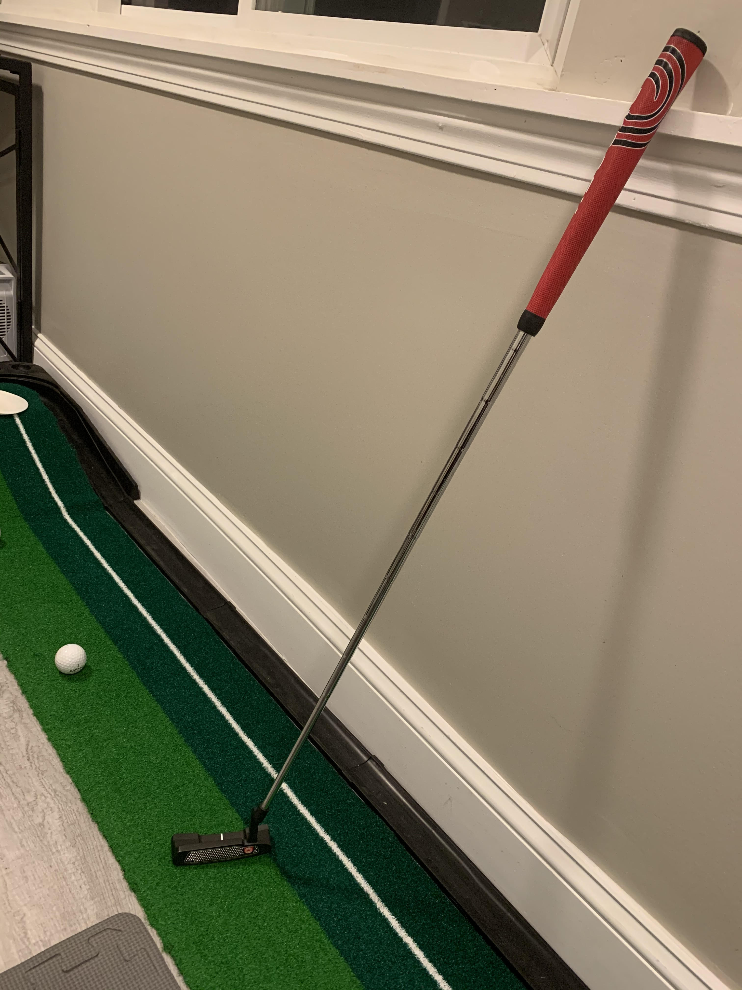
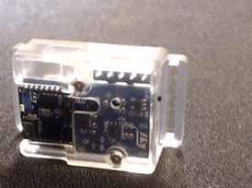

Week-by-week Progress
ST-Link Sensor kit, NUCLEO, Pi 3+, … golf equipment
Tutorials
Week 1-2
Assembling the sensor
Developing data collection software (Pi)
Collecting samples
Week 3
Data cleaning (putt detection)
Feature extraction
Modelling
Prototyping
Week 4
Write-up
Submitting the project

Slide 5
Data Transmission
Sampling rate: 30 ms (?). Probably should have made it more granular
Fields: Timestamp, Acc_X, Acc_Y, Acc_Z, Gyr_X, Gyr_Y, Gyr_Z
GATT
Python client:
Bluepy
Bluez
Variables
True response
Distance
Dataset
Features
Model
Prediction

Slide 6
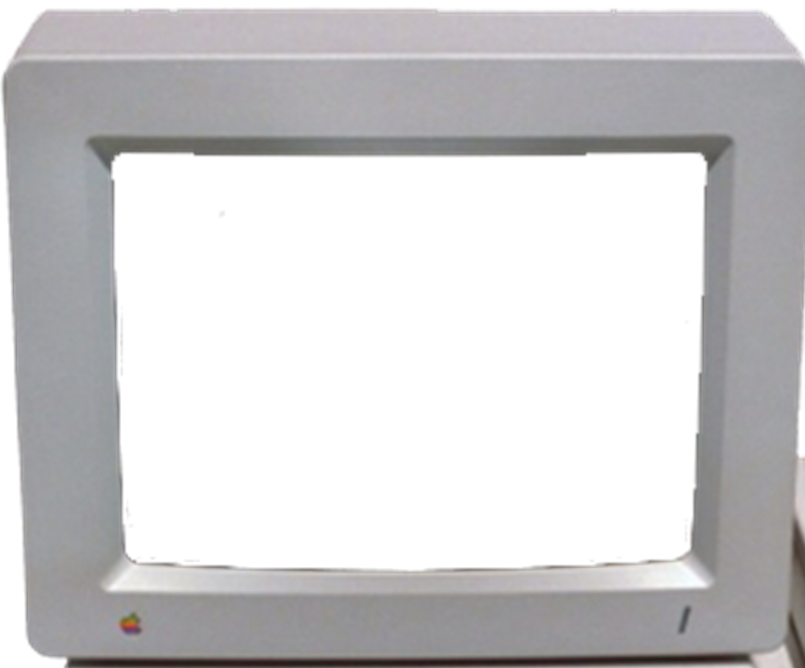
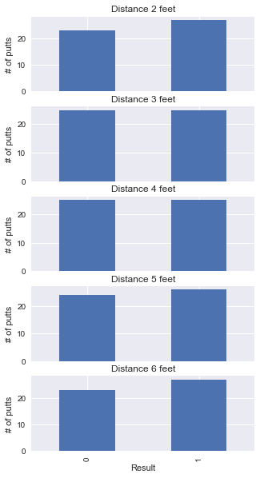
Data Collection
Balanced dataset of 250 observations

Slide 7
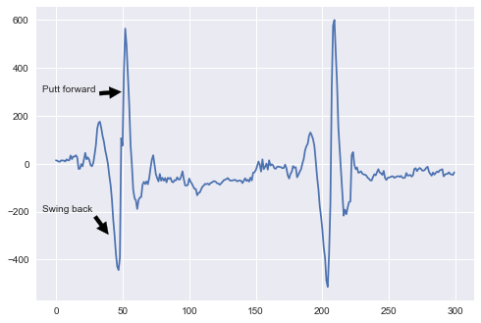
State Machine
State features:
Slight increase in Acc-Z
Action:
Record start of the putt
Start
State features:
Maximum Acc-Z reached
Action:
Expect start
State features:
Monotonically decreasing Z-axis
Action:
Use for a ‘helper’ model
Stop
Back
Accelerometer Z-axis
Forward
State features:
Monotonically increasing Z-axis until maximum
Action:
Store accelerometer and gyro for the model

Slide 8
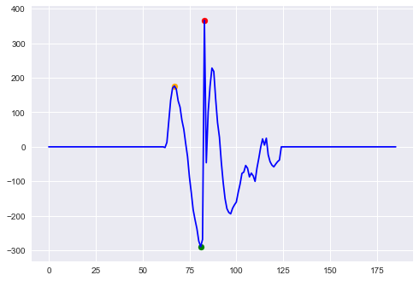
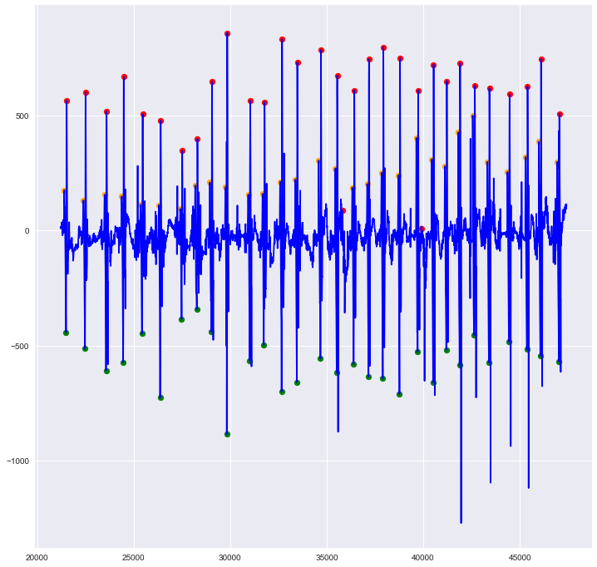
Putt detection
Putt-detection algorithm
Find break though the threshold (1)
Move window left by prespecified margin (25 observations) and find local maximum (2)
Create prespecified window (100 observations) and find local maximum (3)
Find local minimum between (2) and (3)
Left margin
(3)
(2)
Marked dataset of 30 putts
Threshold
(1)
(4)

Slide 9

Model design
Raw inputs
For Acc and Gyro
Exclude
Inputs (Stage 3) offset:
Distance
Gyro (X,Y,Z)
Acc (X,Y,Z)
True response (1/0)
Range
Min, Max, Last
Mean, StDev
Mean StDev of recentered
Vector size
Slope
Based on experiments with feature selection
X-axis for Axx and Gyro
Vector size
Putt forward
Feature selection
Split
Train/validation/test split
- 30/70% test/train (75/175 observations)
- Train is split 30/70 to validation and train (53/122 observations)
1 (hit) / 0 (miss)
Output
Model

Slide 10
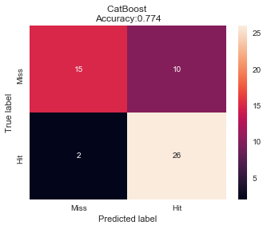
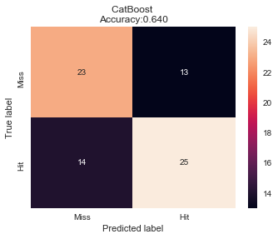
Catboost Precision
Validation set (53 observations)
Test set (75 observations)

Slide 11
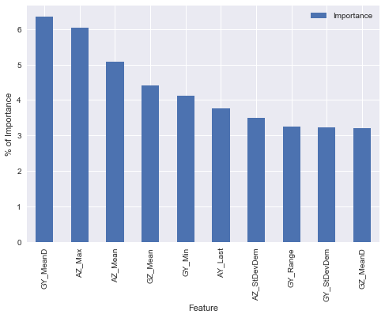
Feature Importance
Top-10 Features

Slide 12

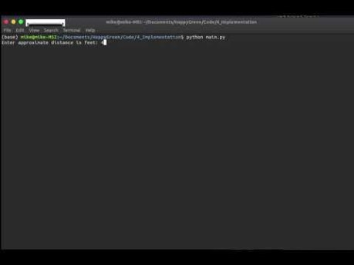
Working prototype
https://youtu.be/--KsTxibZ40

Slide 13
Possible improvements
Collect more data
With the current number of features (37) and observations (122 in train set), overfitting is a big problem
Make data more granular (probably 10ms or less)
Because of low resolution of the data, we have to rely on having many features in the hope to distinguish between successful and unsuccessful putts
Increase the range and granularity of distances

Slide 14
Full Video
https://youtu.be/2S7rDOkyQkU

Slide 15

Unrelated: What to do with Raspberry Pi

